Slide 1
Northwind Revenue Improvement
Andrew Smith
North Star Consulting

Slide 2
Introduction The Northwind Database
91 customers in 21 countries
77 food products from 29 global suppliers
2,155 product sales spanning 18 months
9 Northwind Sales Representatives
51,317 units sold
$1,265,793 in revenue

Slide 3
Methodology
Ask Questions
Formulate Hypothesis
Gather Data
Visualize
Test
Conclusion

Slide 4
Asking Questions
Question 1
Does discount amount have a statistically significant effect on the quantity of a product in an order? If so, at what level(s) of discount?
Question 2
Do employees have a statistically significant effect on order values? If so, does the employee's region have a statistically significant effect?
Question 3
Does the customer's region have a statistically significant impact on the amount of orders they submit?
Question 4
Did items that are now discontinued have a statistically significant difference on order values?

Slide 5
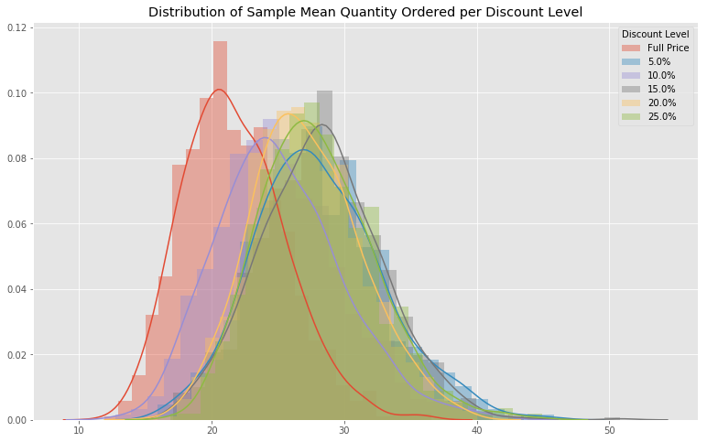
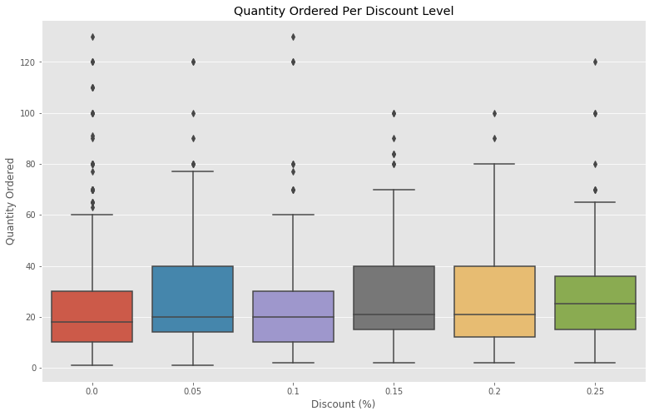
Question 1: Does discount amount have a statistically significant effect on the quantity of a product in an order? If so, at what level(s) of discount?
5

Slide 6
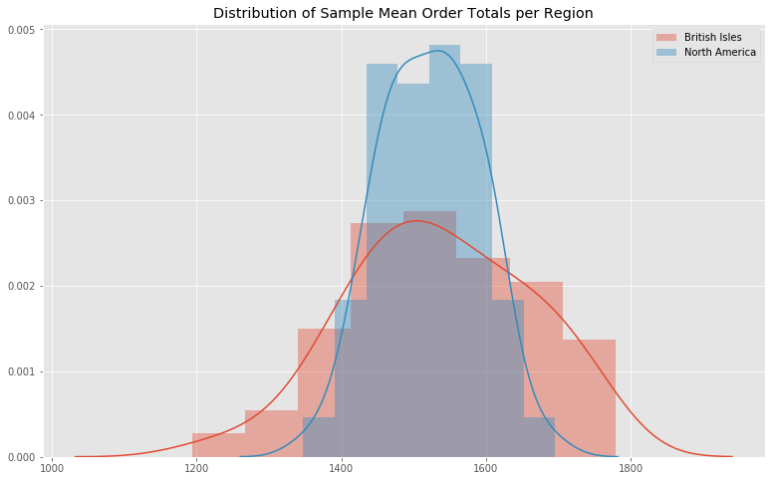
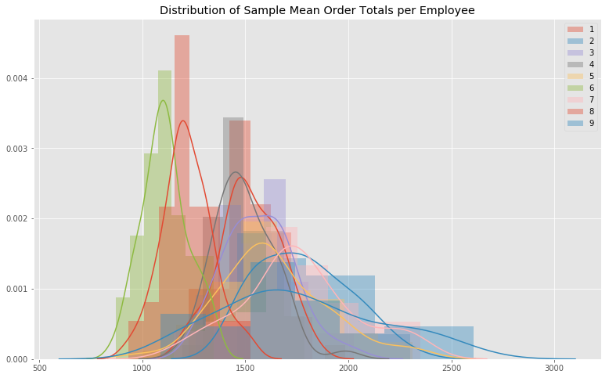
Question 2: Do employees have a statistically significant effect on order values? If so, does the employee's region have a statistically significant effect?

Slide 7
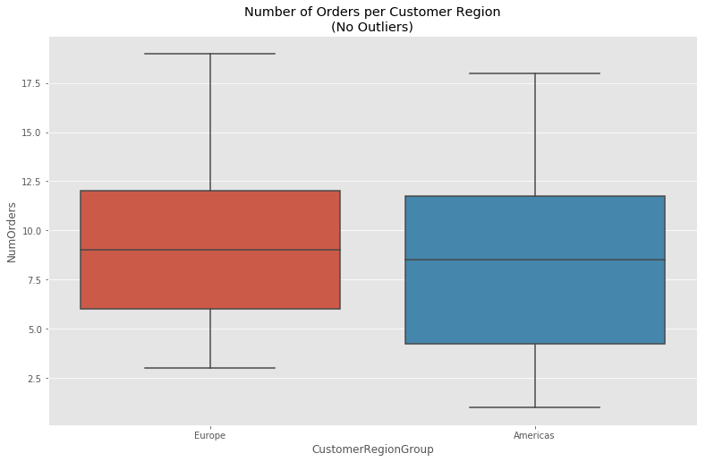
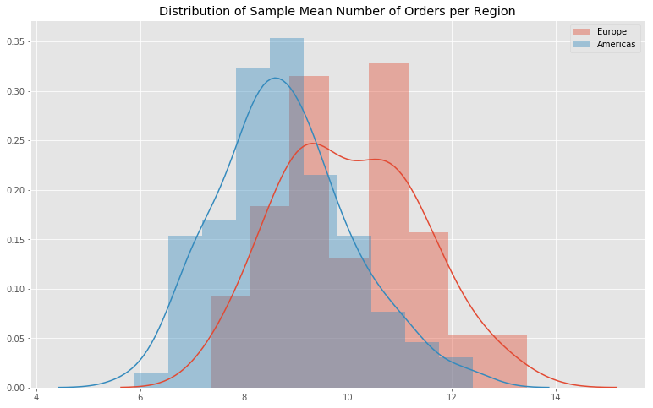
Question 3: Does the customer's region have a statistically significant impact on the amount of orders they submit?
7

Slide 8
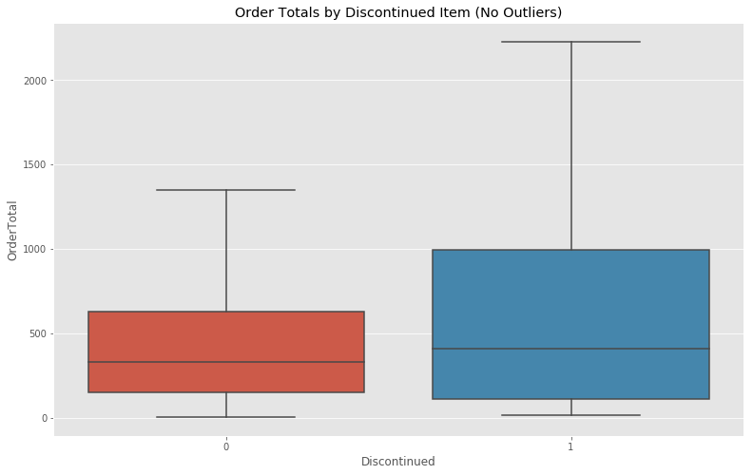
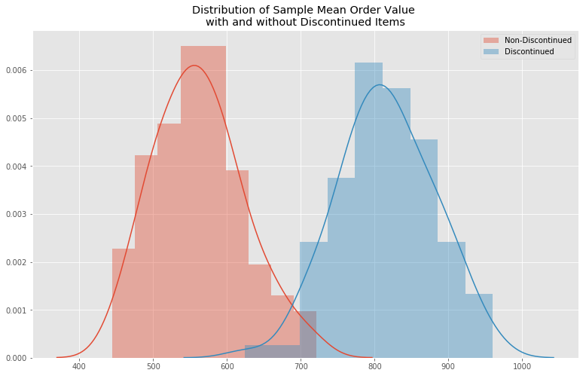
Question 4: Did items that are now discontinued have a statistically significant difference on order values?

Slide 9

Conclusion and Recommendations
Question 1
5%, 15%, and 25% discounts provide the highest increase in quantity sold.
5% provides the highest spread of items sold vs retained revenue.
Question 2
European Sales Reps have both the best and worst average order values.
American Sales Reps are the most consistent, could still learn from the top European reps.
Question 3
European customers submit the most orders on average .
Targeting new European customers should result in higher revenues.
Question 4
Discontinued Items had vastly higher average order values .
Bringing as many back as possible should result in more revenue.

Slide 10
Future Work
Vast amount of unexplored data
Dig deeper into shipping options
Cheapest Shipping Company
Customer Demographics
Stronger Indicators

Slide 11

Thanks!
Any questions?

